Slide 1

SIMPLE LANE DETECTION SYSTEM
BY. EREN DURMAZ

Slide 2
TOPICS
WHAT IS LANE DETECTION SYSTEM?
HOW IT WORKS?
WHICH PROGRAMMING LANGUAGES ARE USED?
TECHNICS AND MODELS
CONLUSION AND FUTURE WORK

Slide 3
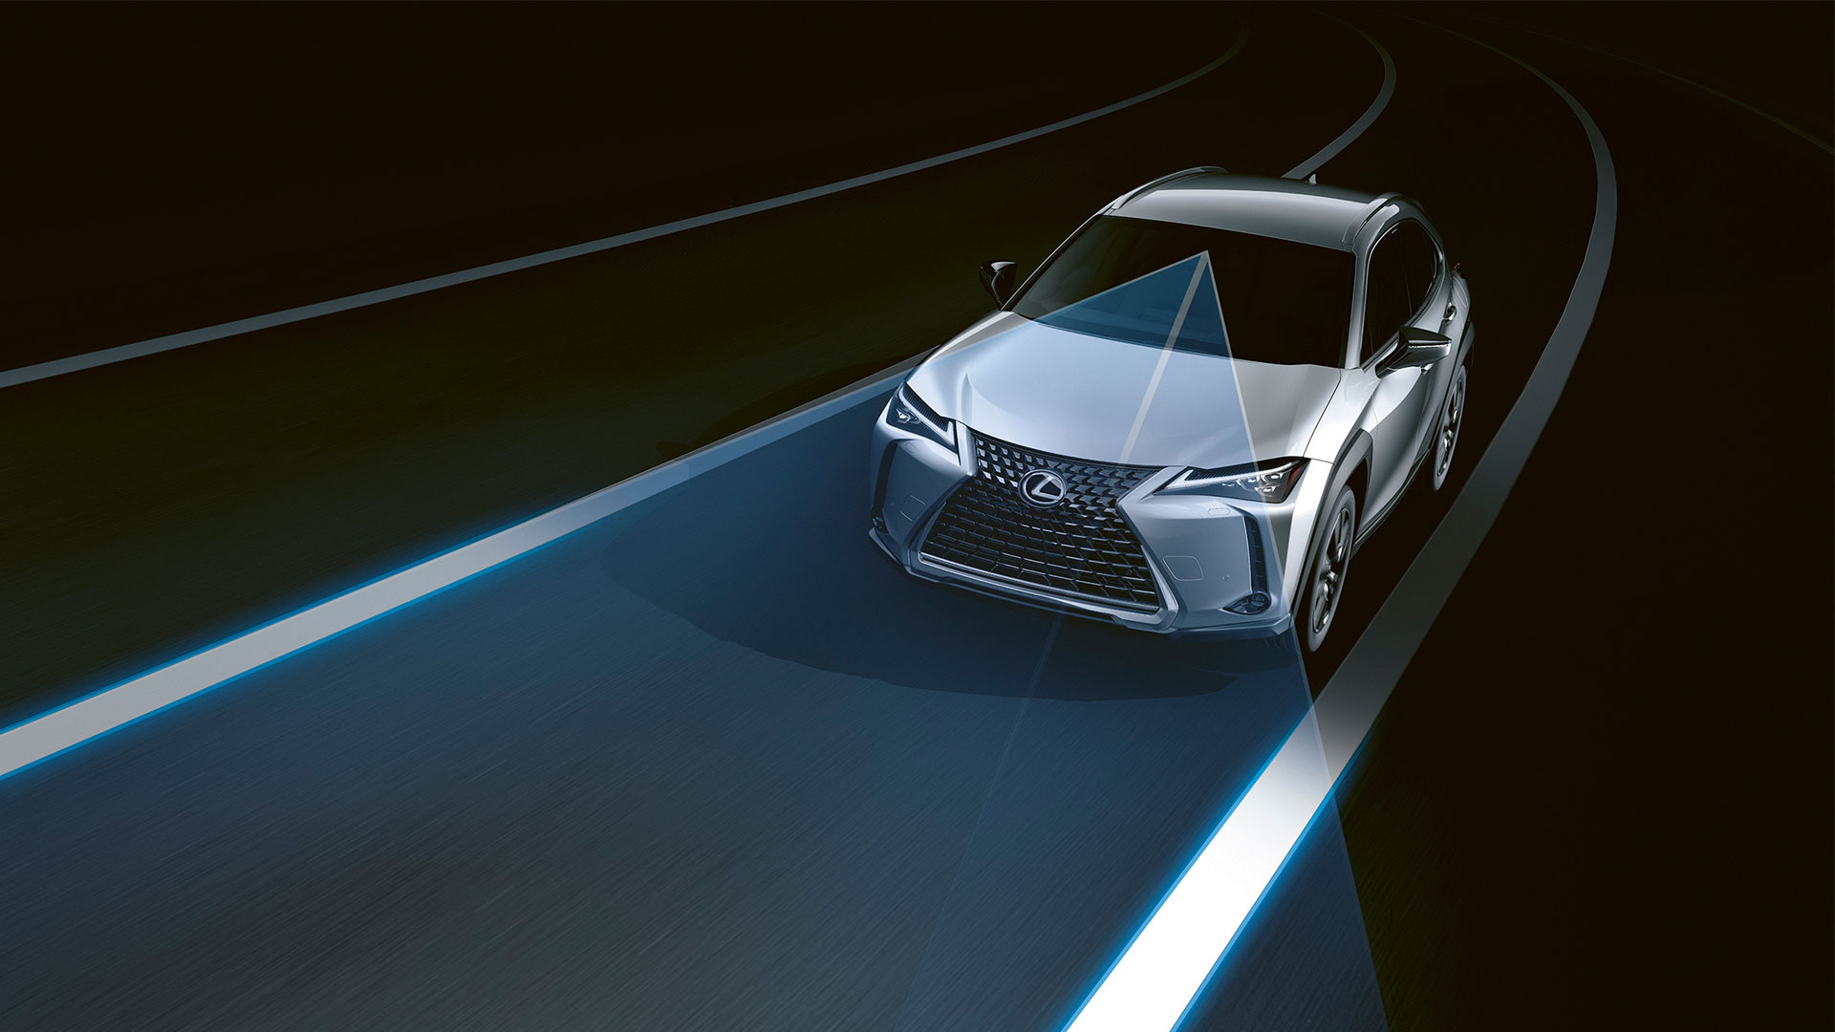
WHAT IS LANE DETECTION SYSTEM?
Lane detection systems are useful in avoiding these accidents
as safety is the main purpose of these systems
Such systems have the goal to detect the lane marks and to warn
the driver in case the vehicle has a tendency to depart from the lane.

Slide 4
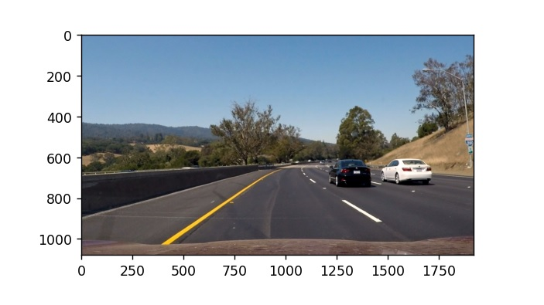
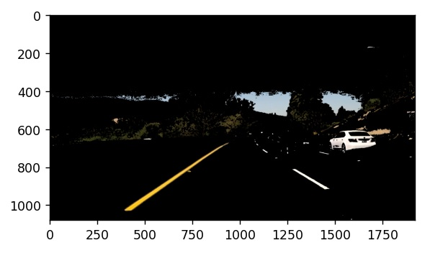
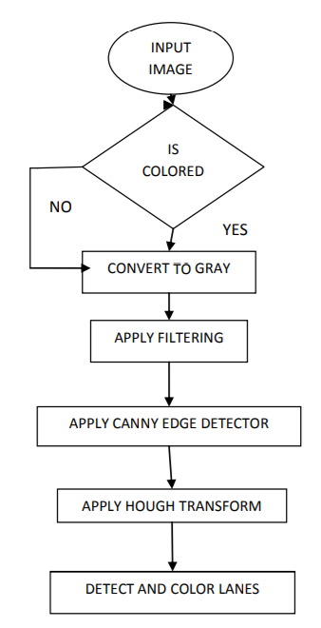
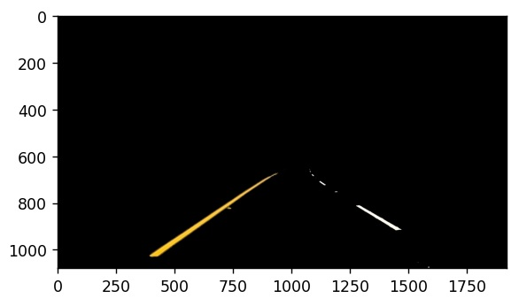
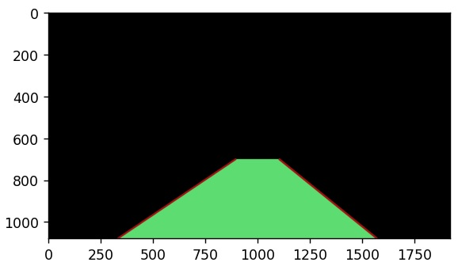

HOW IT WORKS?
Image: shows steps of how it works Lane Detection System
Figure: shows Algorithm of Lane Detection System

Slide 5


WHICH PROGRAMMING LANGUAGES ARE USED?

Slide 6

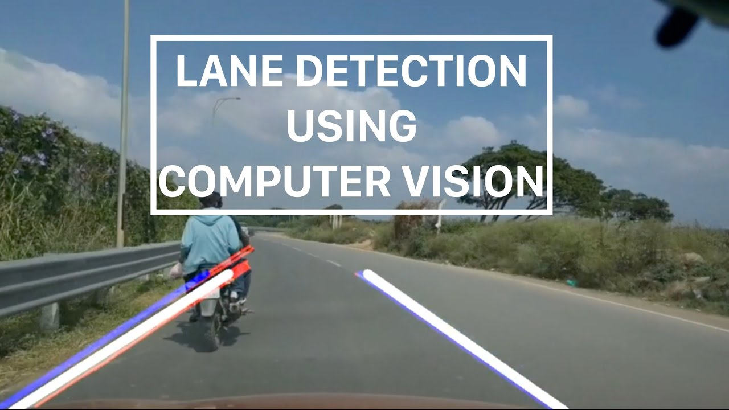
TECHNICS
Convolutional neural network (CNN)
Deep Neural Networks (DNN)
Notes:
Lane Detection, using computer vision techniques has been getting more attention for decades.
These techniques generally are represented by two categories: featurebased, and model-based

Slide 7
COMPUTER VISION MODELS IN LINE DETECTION SYSTEM
Reading Images
Color Filtering in HLS
Region of Interest
Canny Edge Detection
Hough Line Detection
Line Filtering and Averaging
Overlay detected lane

Slide 8
RESULTS USING COLOR FILTERING

Slide 9
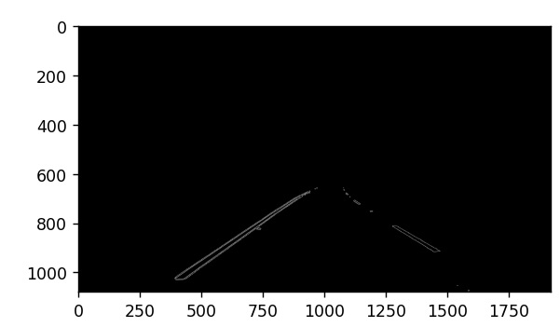
RESULTS USING HOUGH TRANSFORM, CANNY EDGE

Slide 10
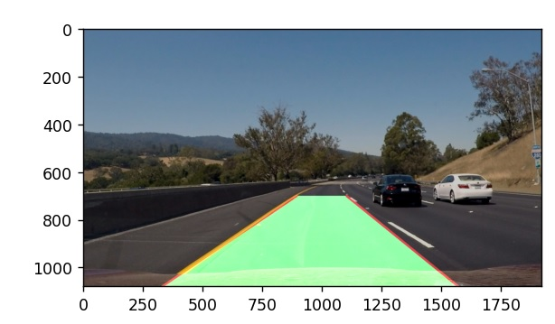
RESULTS USING HOUGH LINE DETECTION

Slide 11
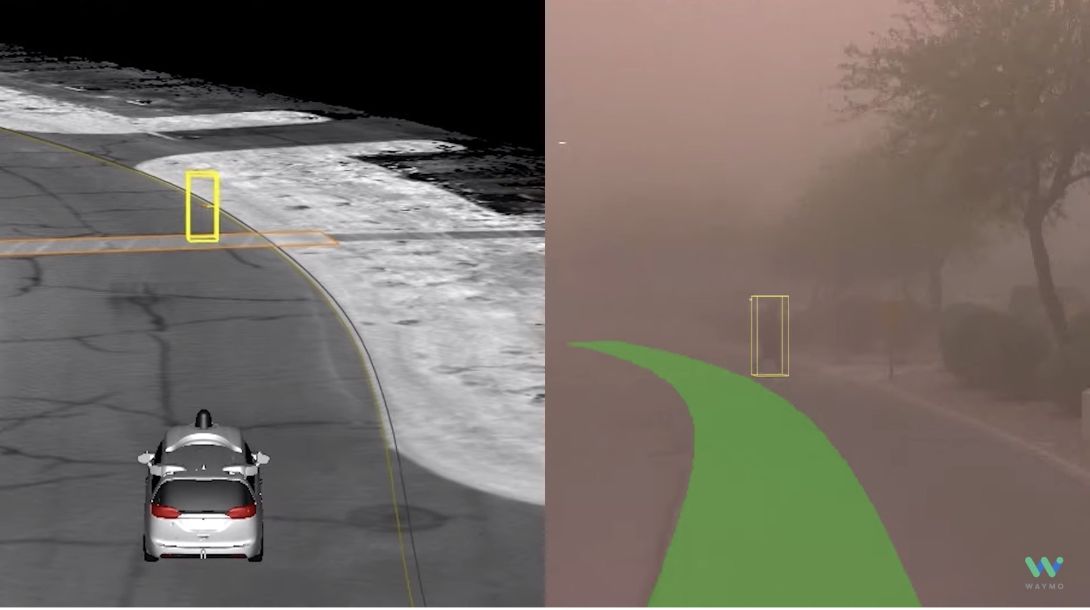
CONLUSION AND FUTURE WORK

